Slide 1
Optimalisasi Pemanfaatan Aplikasi Web UMPalembang
Sayfudin, M.Kom., CSCU.

Slide 2
Beberapa Aplikasi UMPalembang
Website Institusi
Repository Institusi
E-Learning
SIMSDM / PENMARU
Digital Library
1
2
3
4
5

Slide 3
Website Institusi (Fakultas / Prodi)
Optimaslisasi Search Engine
Index Google.
05
Digital Library
Online Public Catalog
Android App
01
04
SIMSDM, SIMAKAD
PENMARU host-to-host
Repository
Google Scholars
Peringkat Webometric
RAMA (Repository Tugas Akhir Mahasiswa).
02
03
E-Learning
Fitur terbaru.
SPADA

Slide 4
Website Institusi (Fakultas / Prodi)
1

Slide 5
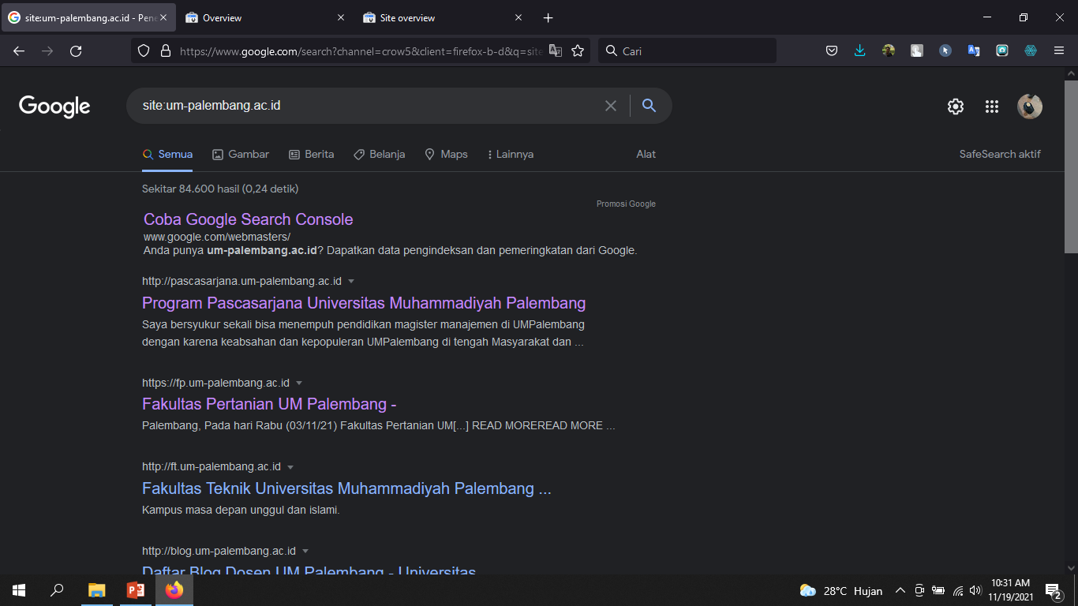
Website Institusi (Fakultas / Prodi)
1

Slide 6
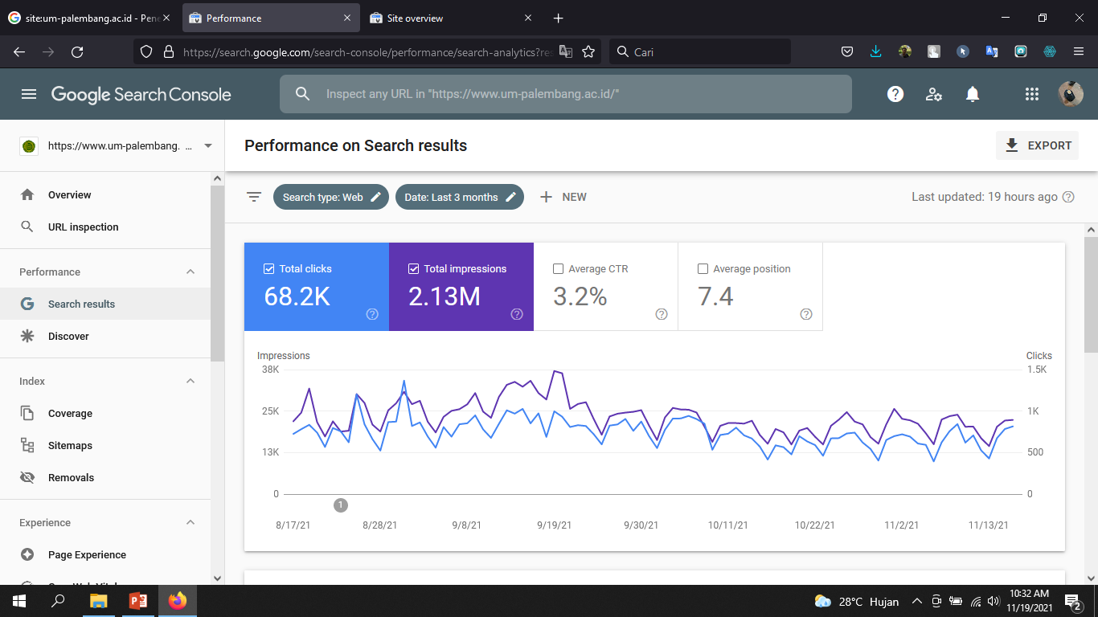
Website Institusi (Fakultas / Prodi)
1

Slide 7
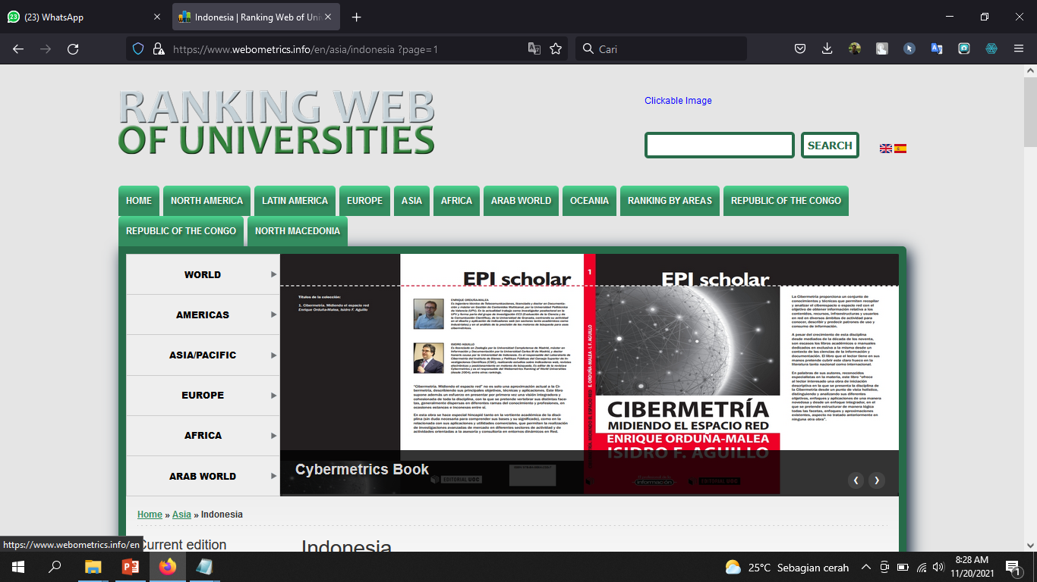
Website Institusi (Fakultas / Prodi)
1

Slide 8
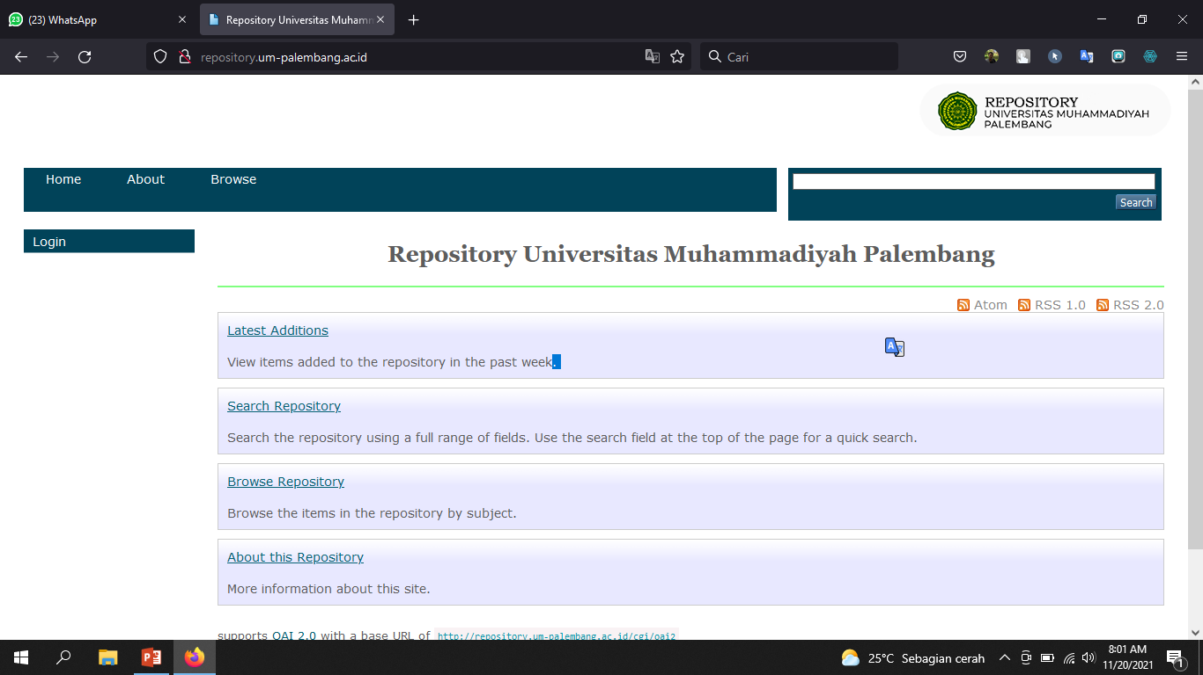
Repository
2

Slide 9
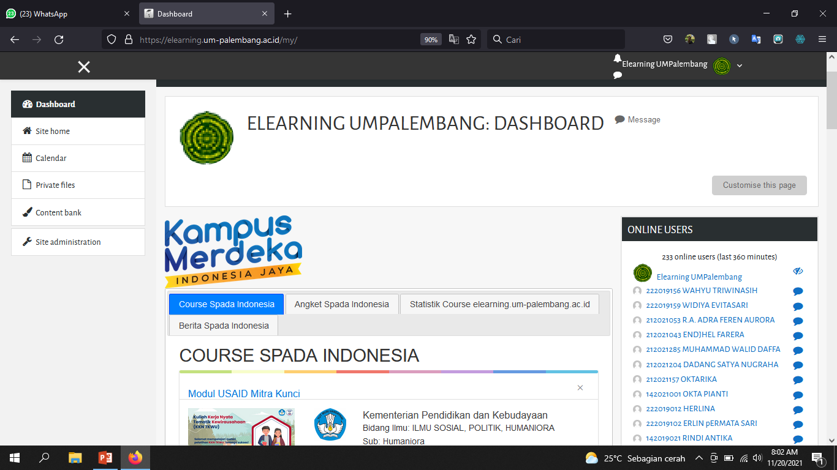
Elearning
3

Slide 10
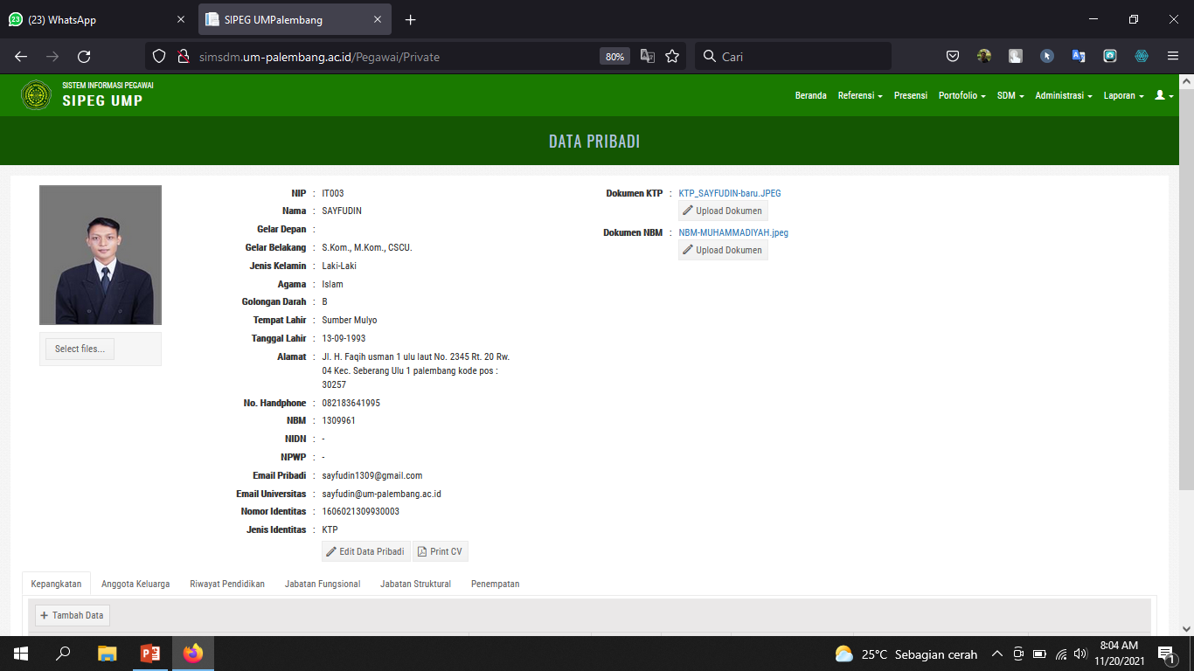
SIMSDM
4

Slide 11
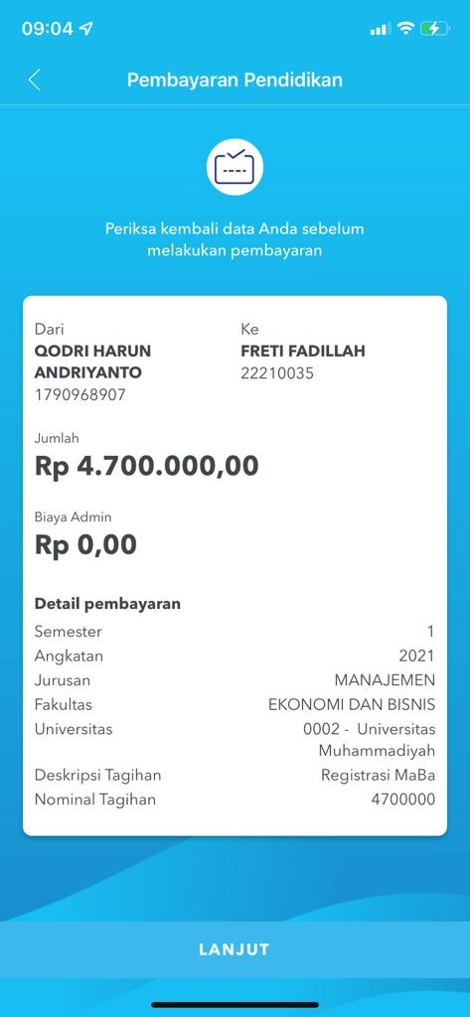
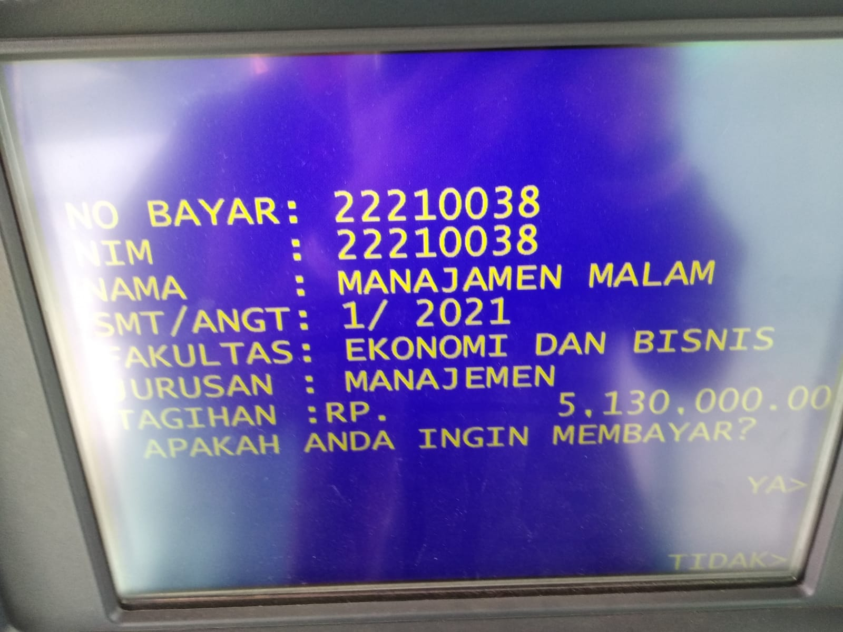
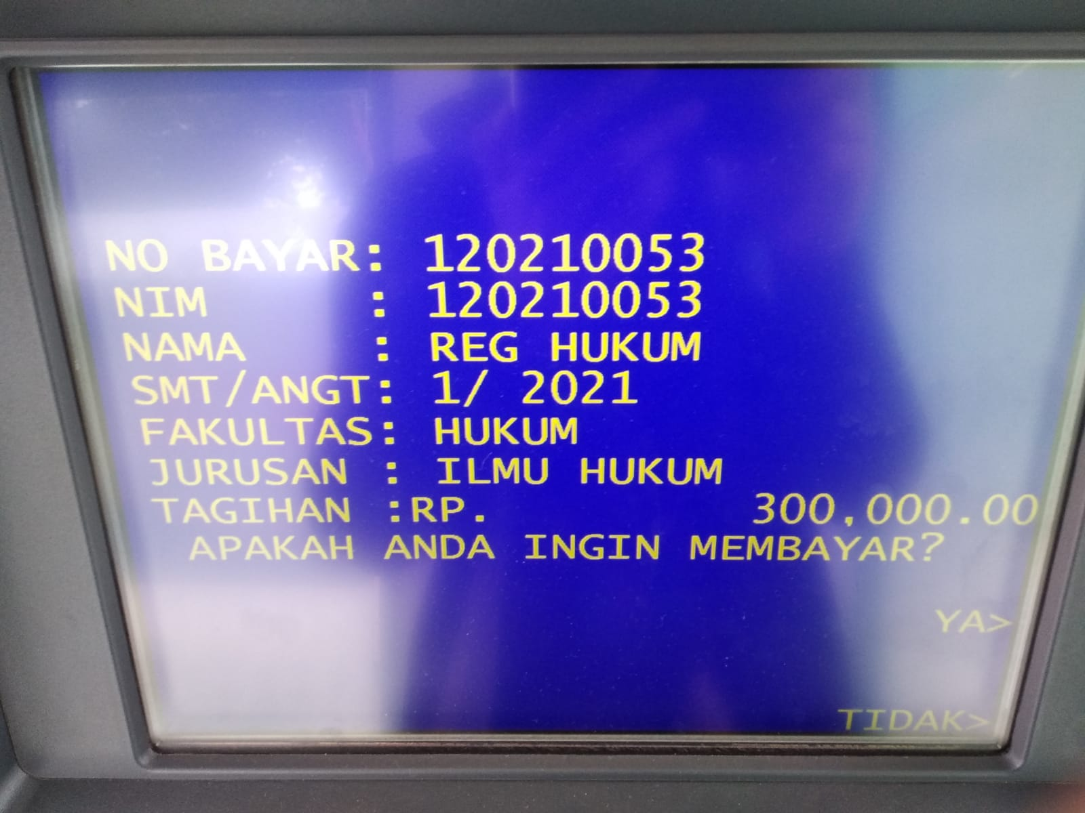
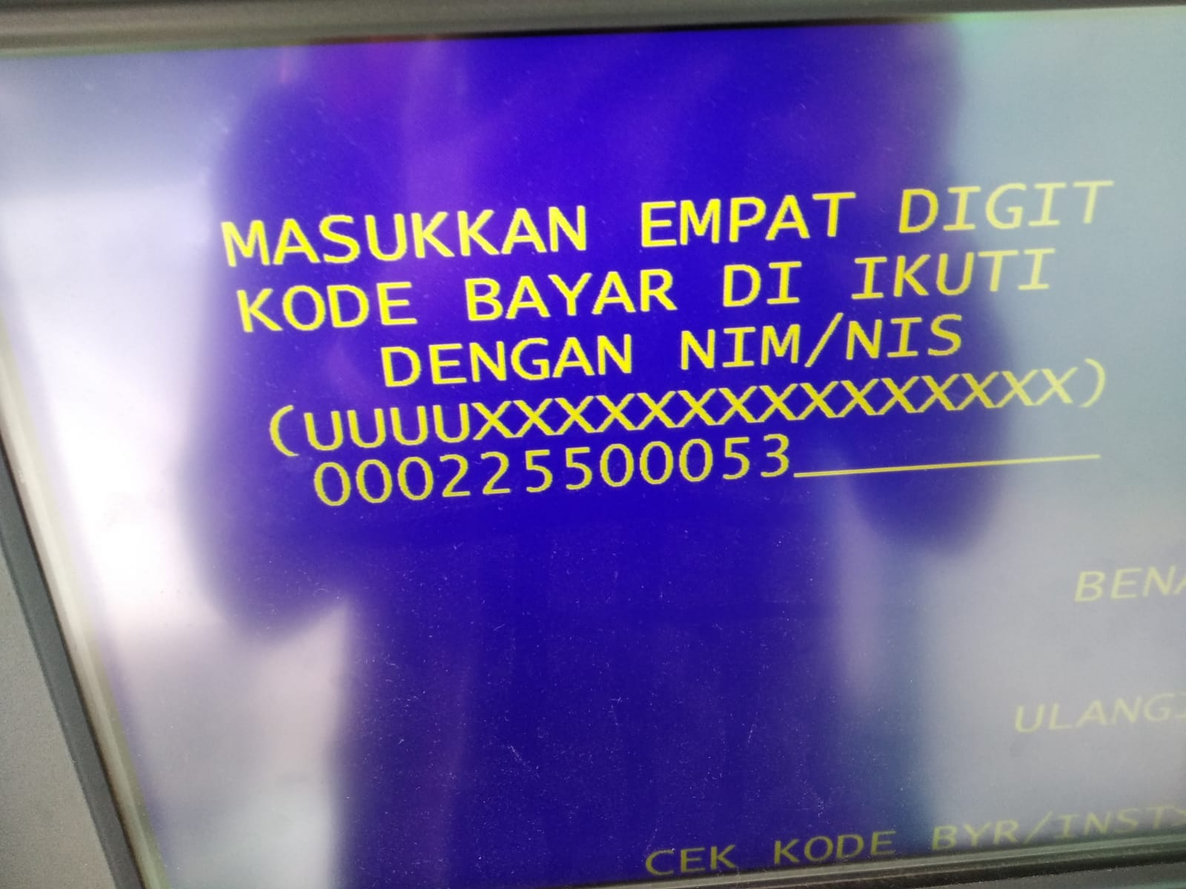
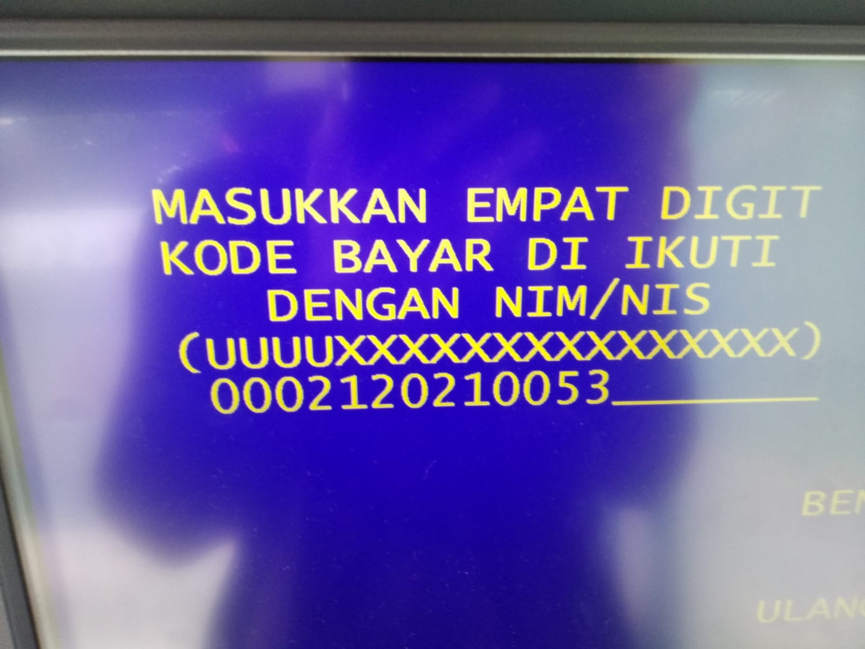
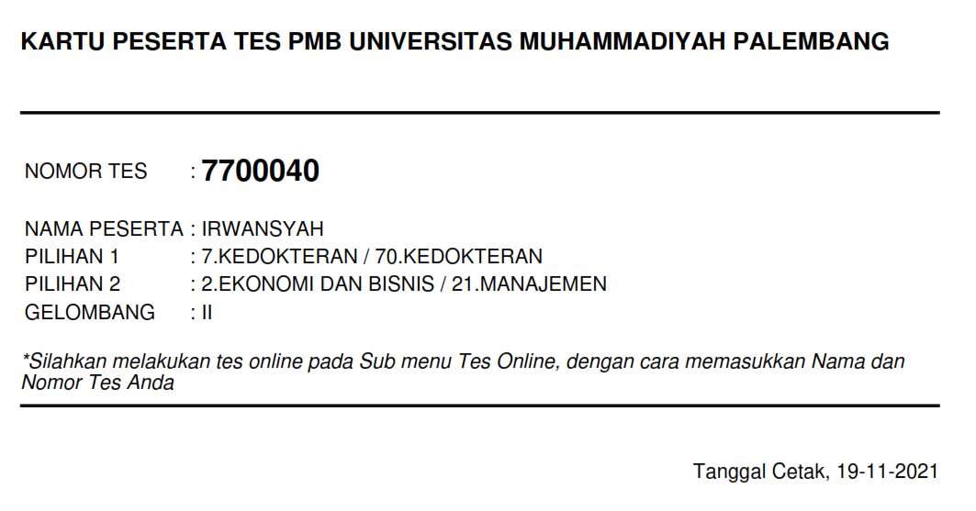
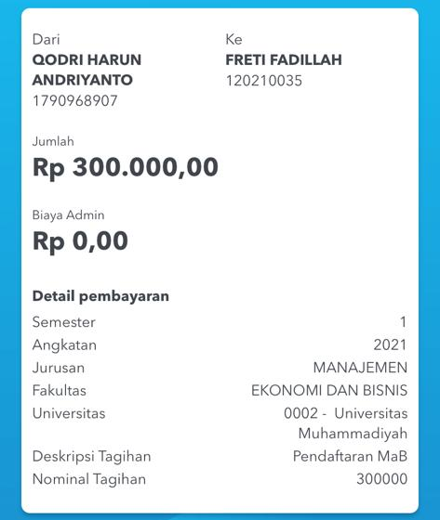
PENMARU
4

Slide 12
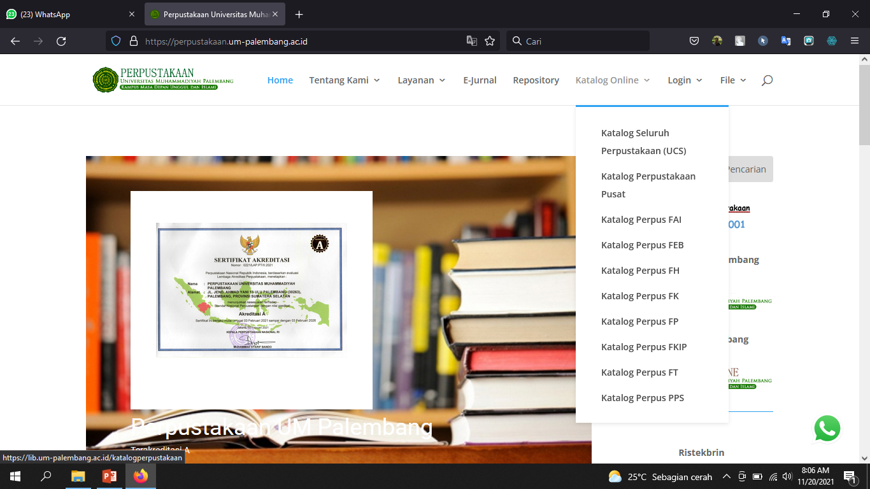
DIGILIB
5

Slide 13
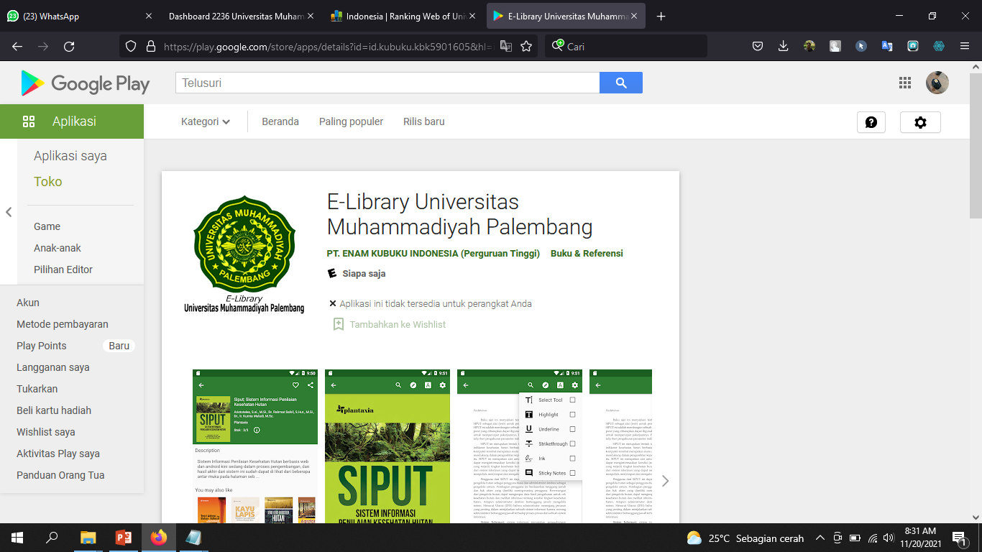
DIGILIB
5

